Slide 1
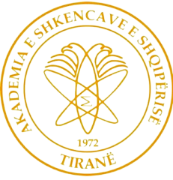


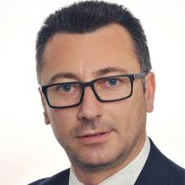
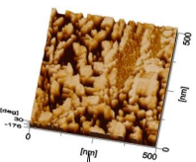
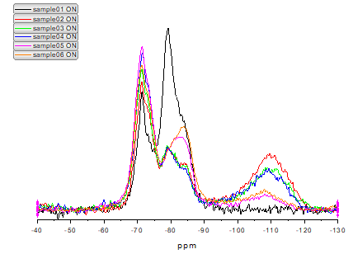
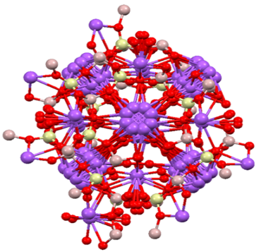
SUSTAINABLE, NANOSTRUCTURED BUILDING MATERIALS GROUP
Contact person/Group leader:
Prof. Dr. Arjan KORPA
Affiliation
Department of Chemistry, Faculty of Natural Sciences, University of Tirana, Albania
Mail address
Office 330, building A, blv. Zogu I, No. 25/1, 1001 Tirana, Albania
Email/website
arjan.korpa.edu.al; arjan.korpa@unitir.edu.al
https://fshn.edu.al/departments/departamenti-i-kimise/personel/prof-dr-arjan-korpa
Group Members
Prof. Dr. Arjan Korpa; MSc. Sara Dervishi; Msc. Kristi Shahu, Msc. Diana Gecaj, Bsc. Sibora Bita, Bsc. Denis Kotorri
Google Scholar
https://orcid.org/0000-0002-5103-3676
Research Gate
https://www.researchgate.net/profile/Arjan-Korpa
Research lines
Research, development and characterization of building and related materials.
Nanostructure modification and surface functionalization of building and related materials.
Development of multifunctional building materials through transfer of structural principles from biological systems using nanotechnology.
Industrial waste treatment and utilization for development of sustainable innovative binders and building materials.
Natural, synthetic and chemically modified materials for environmental applications.
Restoring and preservation of old historic structures and objects.

